Slide 1

Statistical Tests for Missing Data
Arun B Ayyar

Slide 2


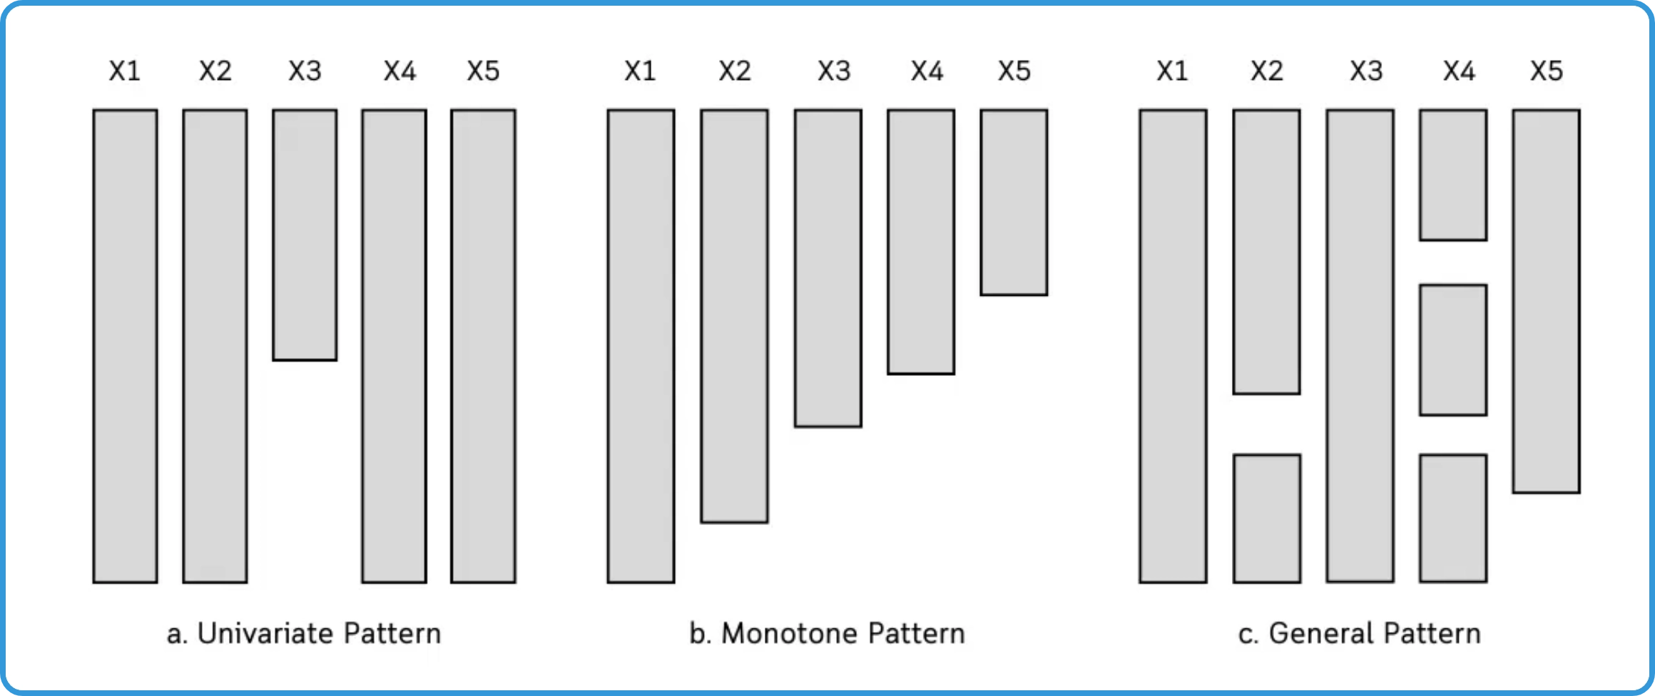



Introduction to Little's MCAR Test
What is Little's MCAR Test?
A statistical test developed by
Roderick J.A. Little (1988) to determine if data are Missing
Completely At Random (MCAR).
Historical Background:
Published in the Journal of the
American Statistical Association (1988) as "A Test of Missing
Completely at Random for Multivariate Data with Missing
Values".
Purpose:
To provide statistical evidence that missing data
mechanism is MCAR, rather than relying on assumption
alone.
When to Use:
Before applying methods that require MCAR
assumption (e.g., listwise deletion), or to determine
appropriate imputation strategy.
Key Insight:
Failure to reject the null hypothesis suggests
MCAR may be plausible, but does not prove MCAR.

Slide 3


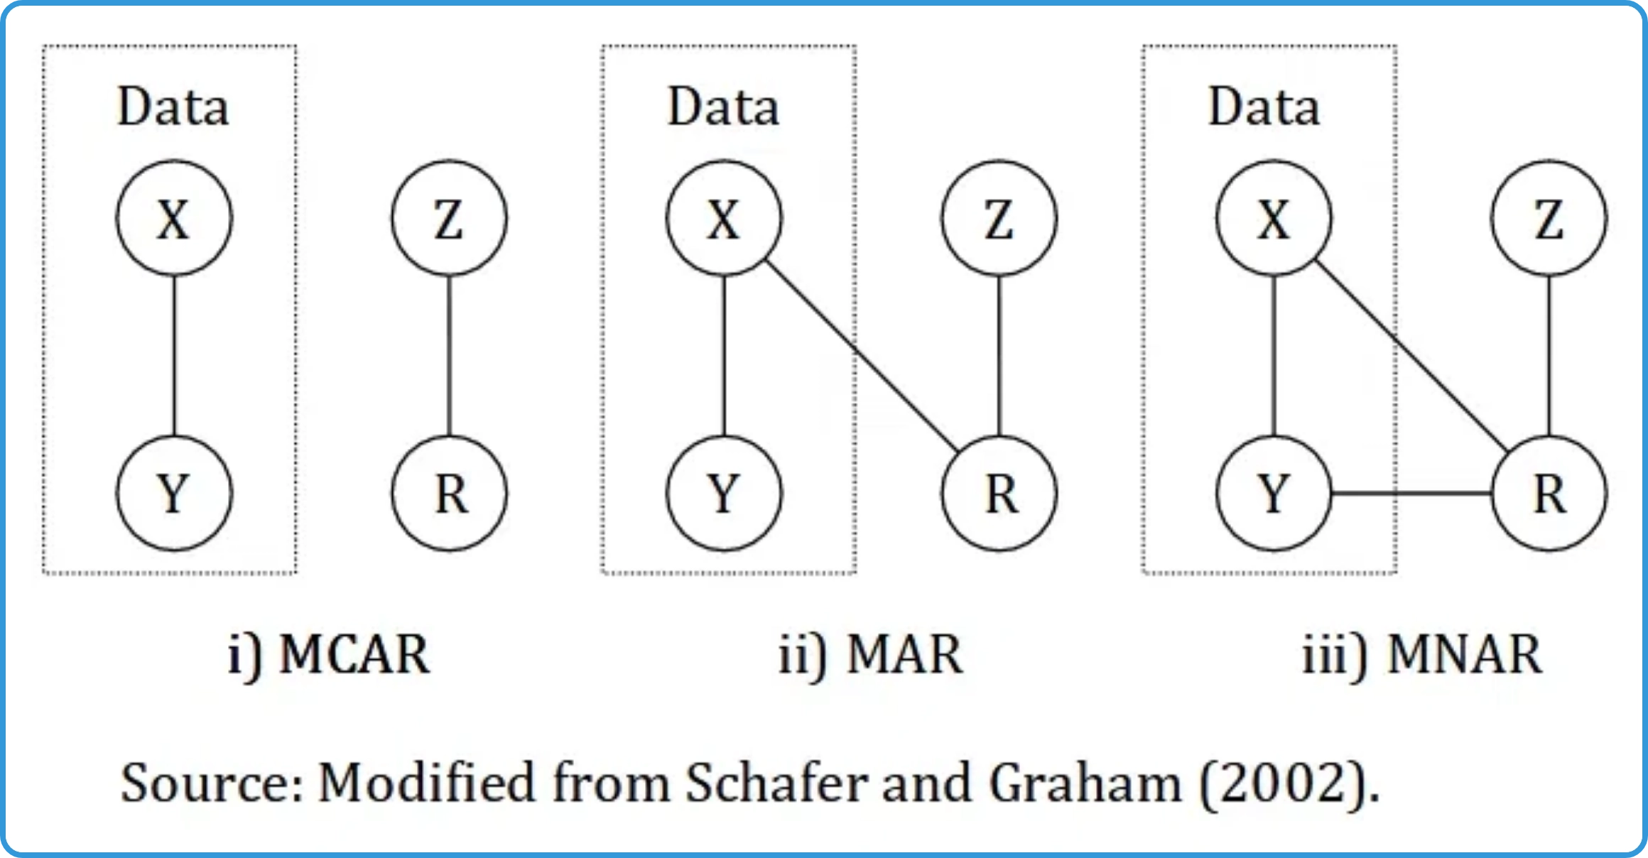



Intuition Behind Little's MCAR Test
Core Concept:
If data are MCAR, the pattern of
missingness should be completely random and unrelated
to any variables in the dataset.
Testing Approach:
Compare means of observed data
across different missing data patterns. If MCAR, these
means should not differ significantly.
Intuitive Example:
If blood pressure readings are MCAR,
the average age of patients with missing BP should be
similar to those with recorded BP.
Why Test MCAR?
Many traditional methods (listwise
deletion, pairwise deletion) are only valid under MCAR
conditions.
Real-World Analogy:
Like testing if a coin is fair by
checking if heads and tails appear with equal probability,
regardless of when or how the coin is flipped.

Slide 4
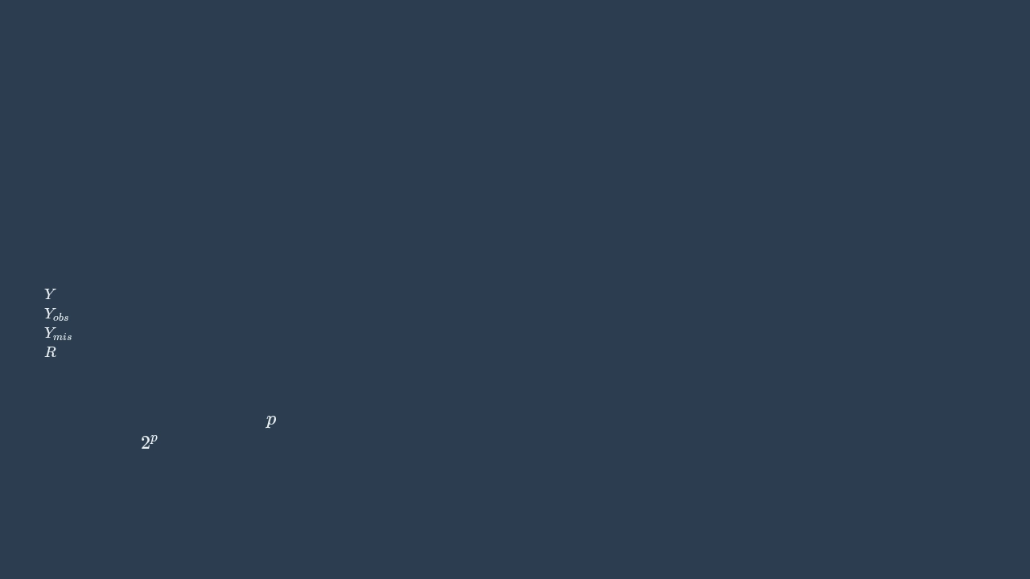

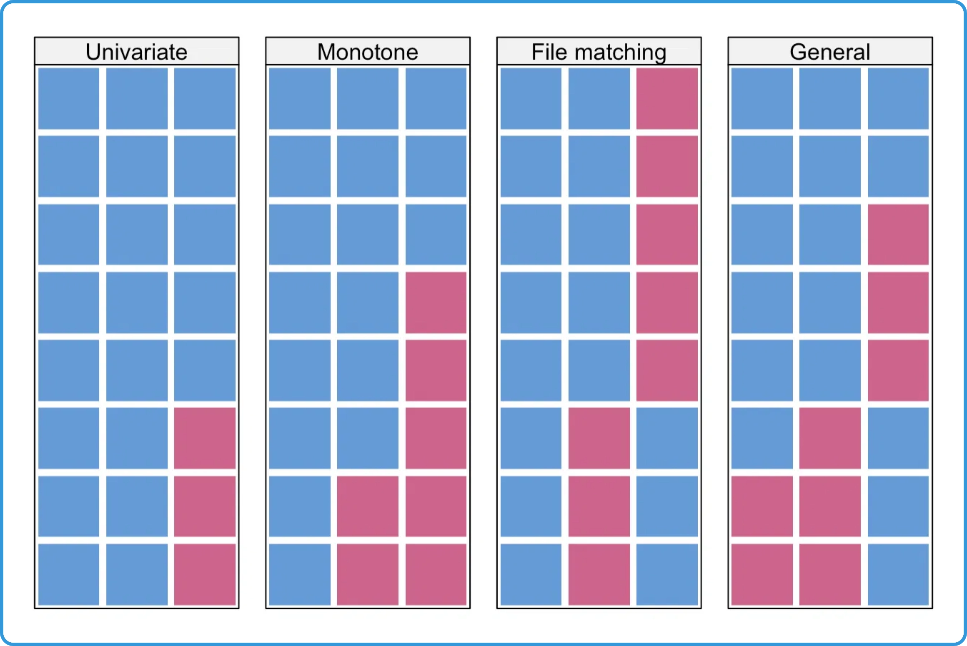


Mathematical Foundation of Little's Test - Part 1
Null Hypothesis (H₀):
The data are Missing Completely At
Random (MCAR)
Alternative Hypothesis (H₁):
The data are not MCAR (either
MAR or MNAR)
Basic Notation:
: Complete data matrix (observed + missing)
: Observed part of the data
: Missing part of the data
: Missing data indicator matrix (1 = observed, 0 = missing)
Missing Data Patterns:
Group observations by their
pattern of missingness. For
variables, there are
potentially
different patterns.

Slide 5
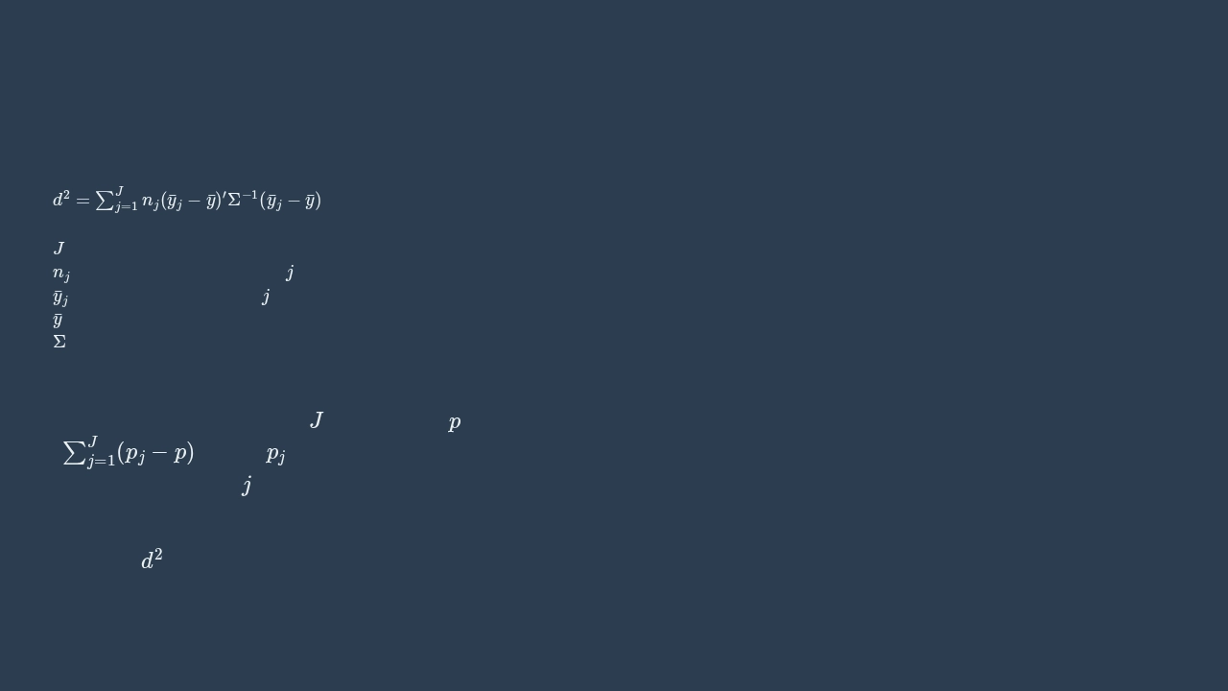

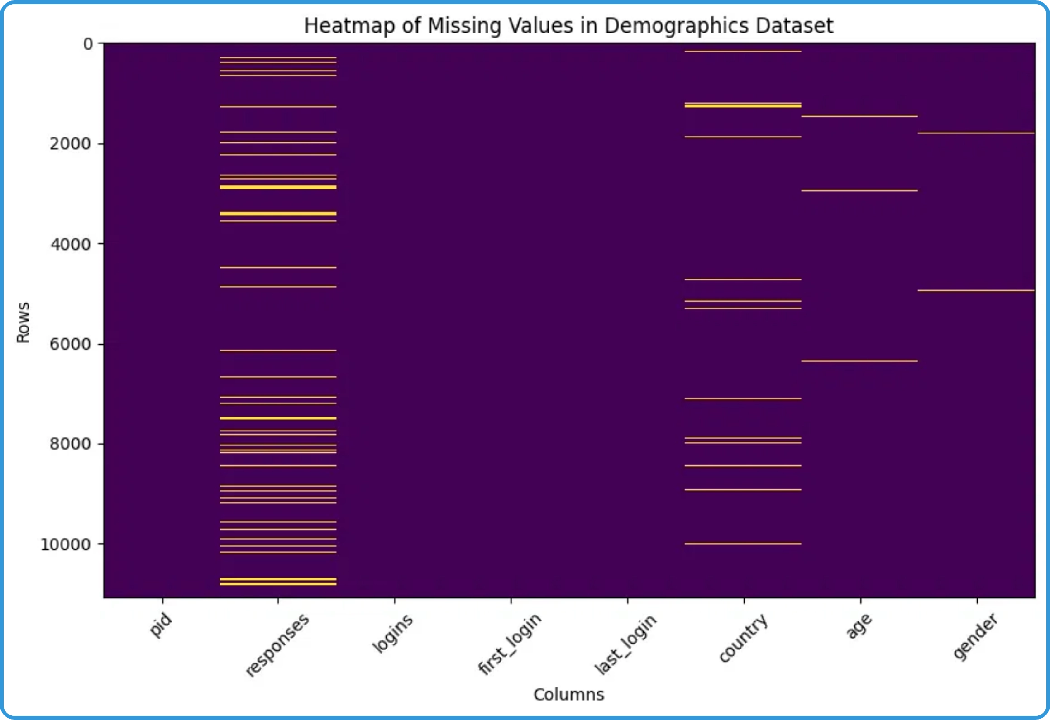


Mathematical Foundation of Little's Test - Part 2
Test Statistic Formula:
Where:
= number of missing data patterns
= number of cases in pattern
j
= mean vector for pattern
j
= overall mean vector
= covariance matrix
Degrees of Freedom:
Calculated based on the number of
patterns and variables. For
patterns and
variables, df =
is the number of observed
variables in pattern
j
.
Distribution:
Under the null hypothesis (MCAR), the test
statistic
follows a chi-square distribution with the
calculated degrees of freedom.

Slide 6


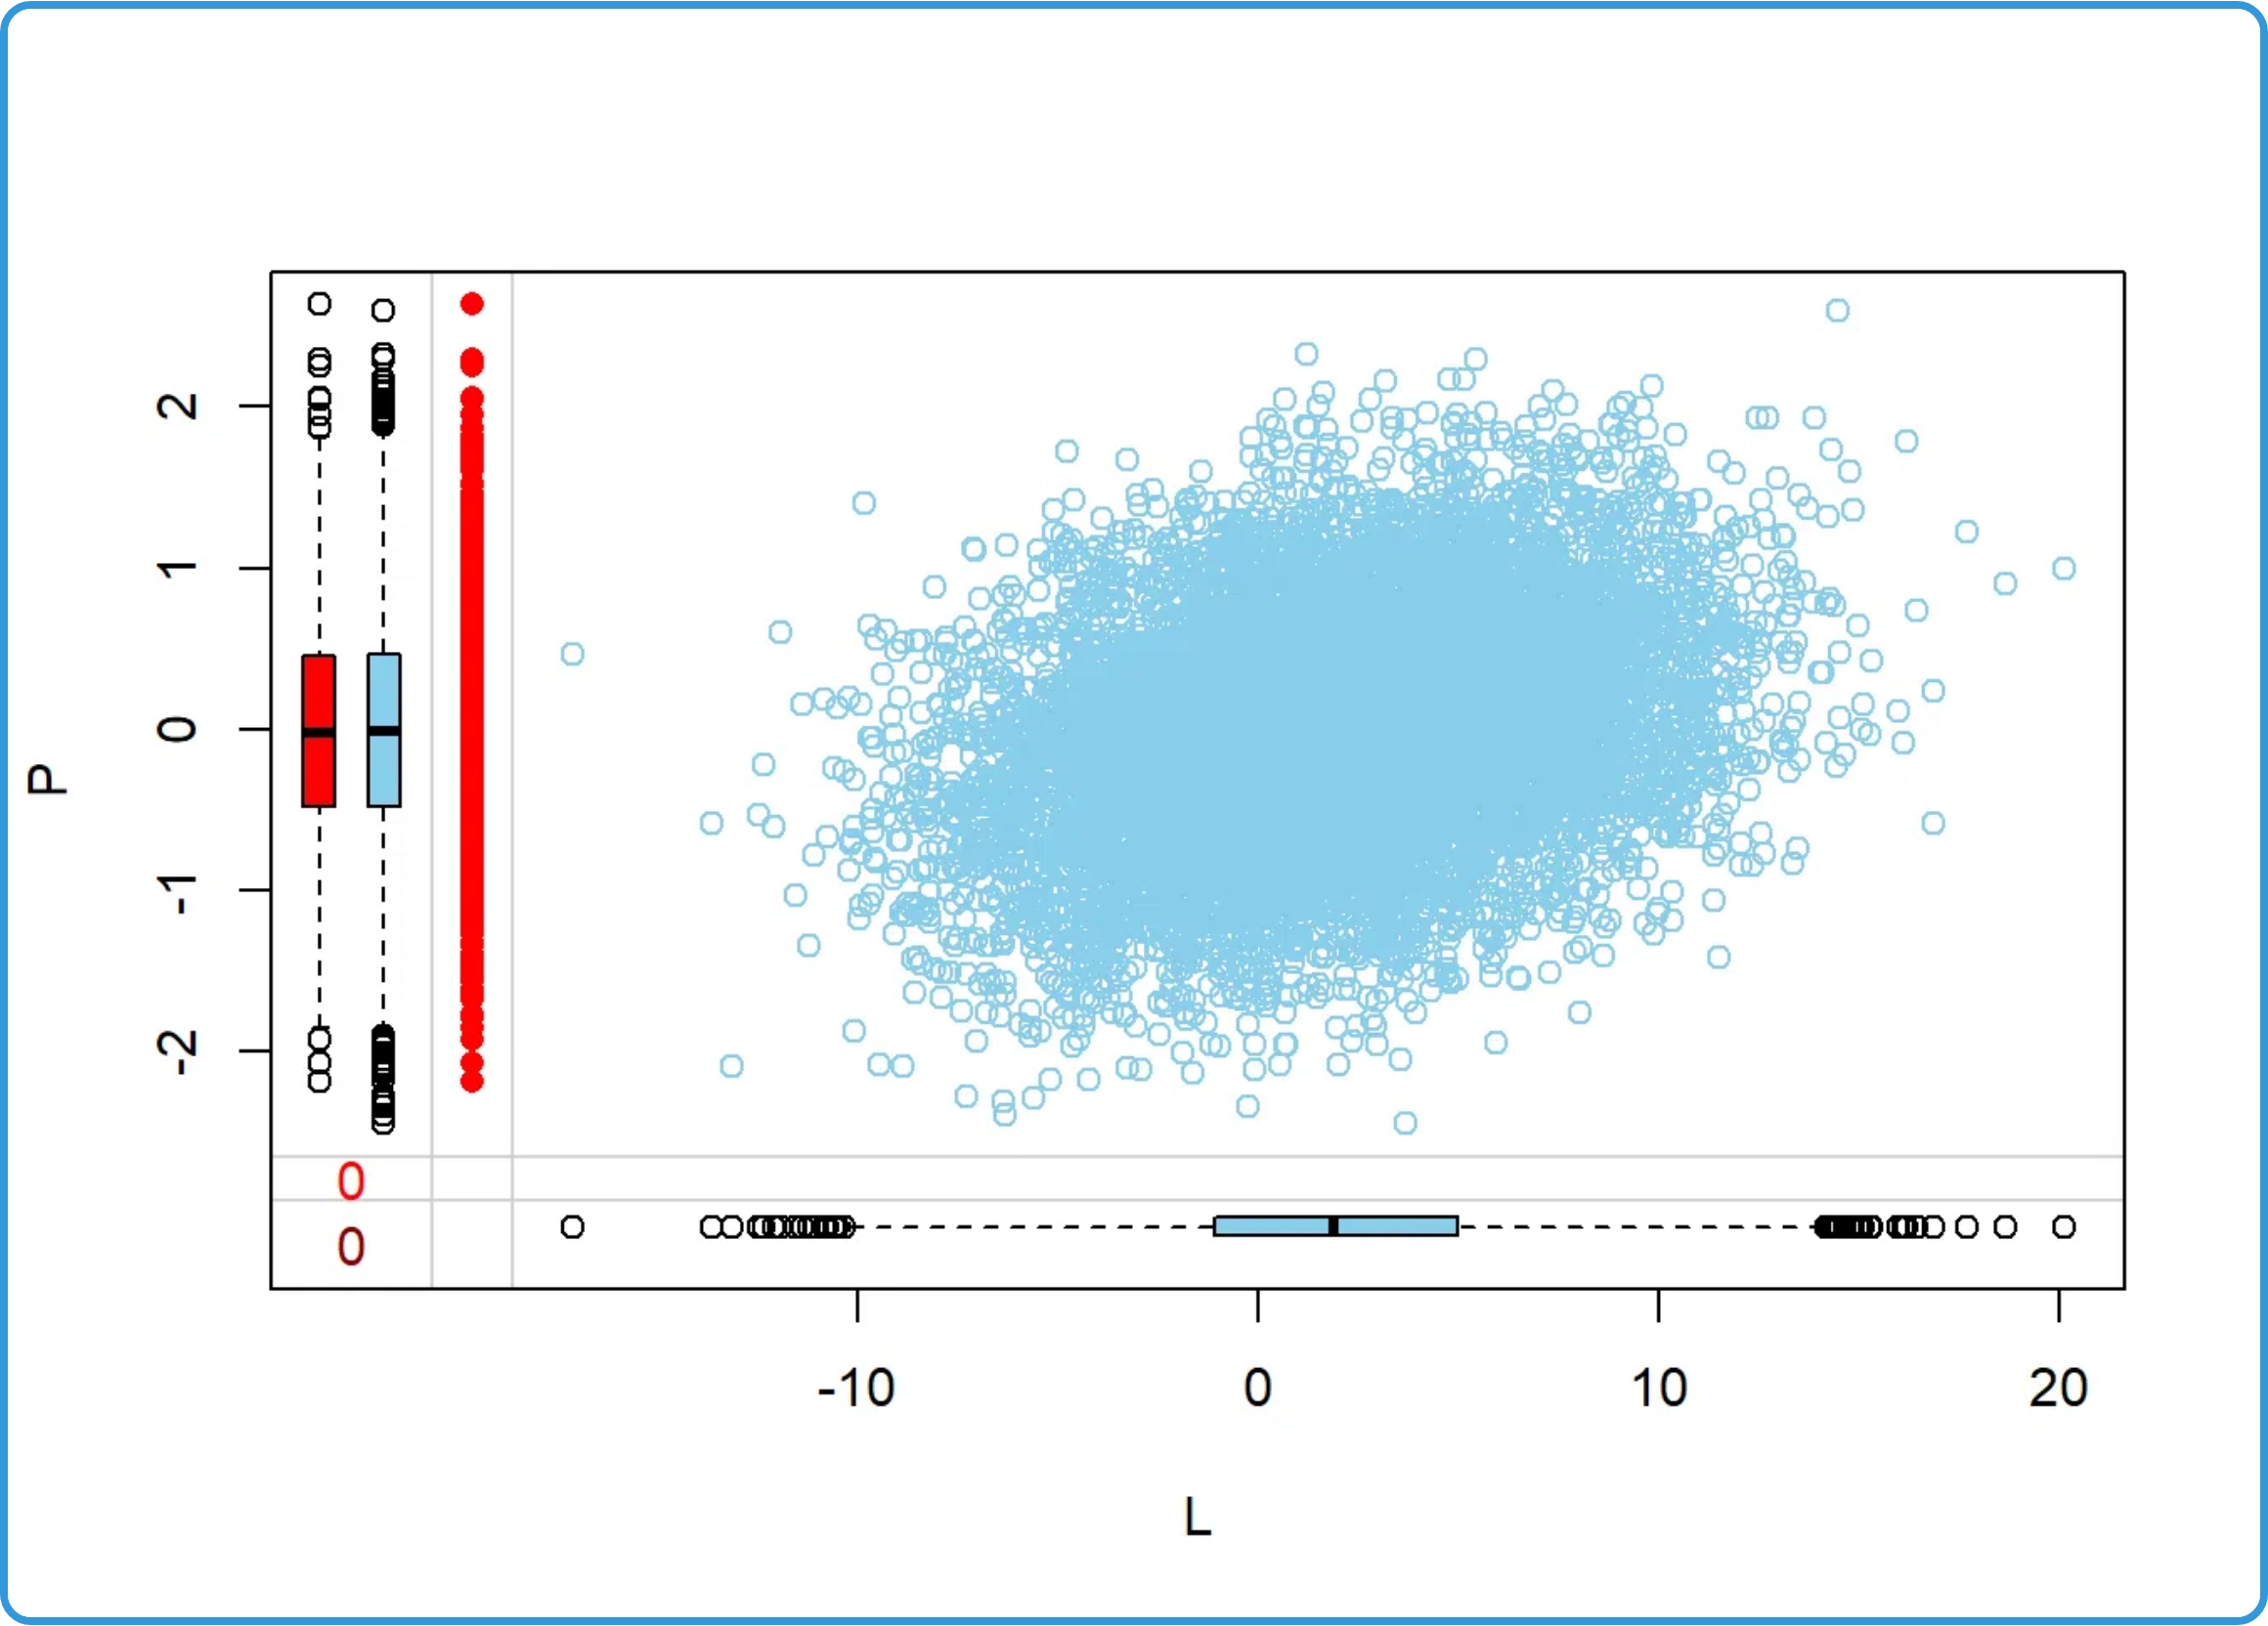



Implementation and Assumptions of Little's Test
Multivariate Normality Assumption:
Little's test assumes
that the data follow a multivariate normal distribution.
Sample Size Requirements:
More reliable with larger
sample sizes (n > 200). Small samples may lack power to
detect non-MCAR patterns.
Software Implementation:
Available in R (naniar,
MissMech packages), SPSS (MVA module), and SAS (PROC
MI).
Step-by-Step Procedure:
1. Identify all missing data patterns in dataset
2. Calculate means for each variable in each pattern
3. Compute test statistic comparing these means
4. Compare to chi-square distribution
5. Interpret p-value (p < 0.05 rejects MCAR)

Slide 7
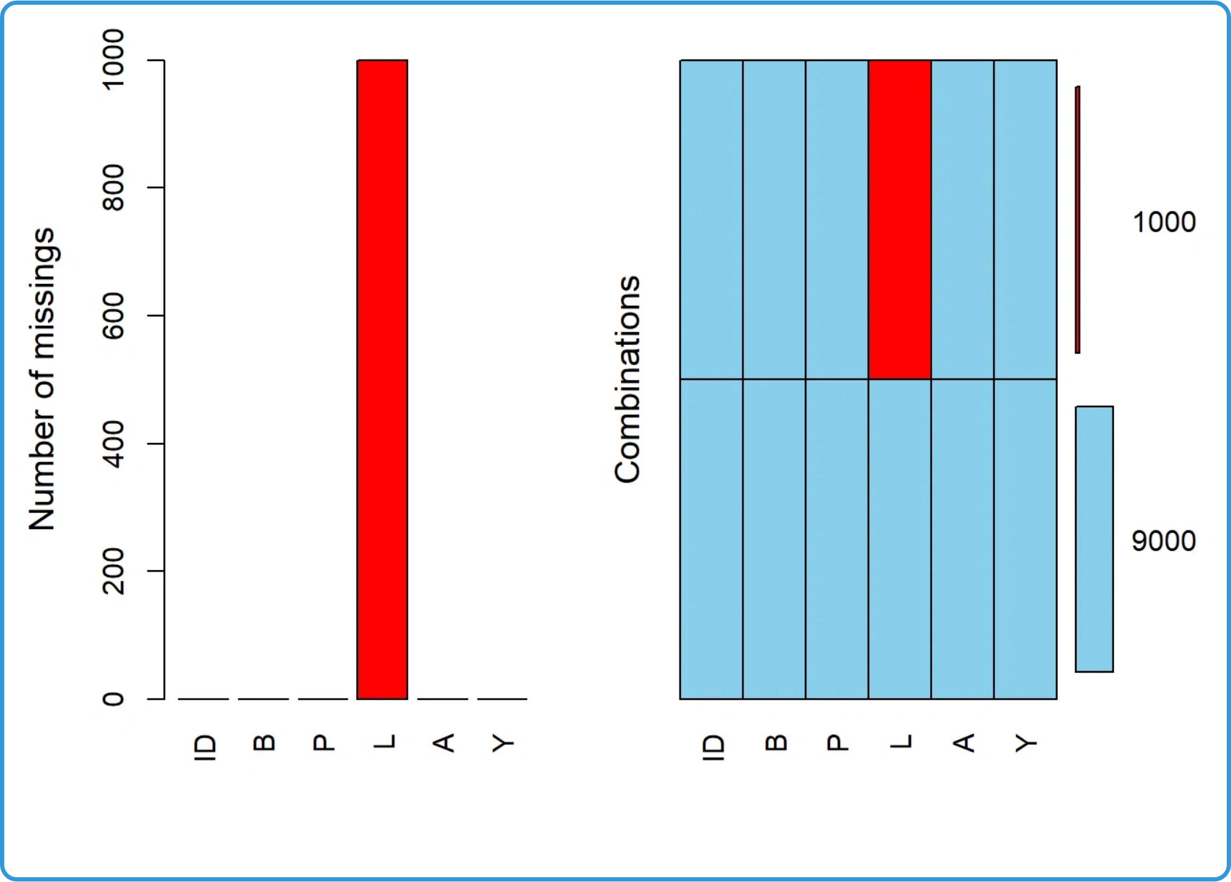

Interpretation and Limitations of Little's Test
Interpreting p-values:
p < 0.05:
Reject H₀, data are not MCAR
p ≥ 0.05:
Fail to reject H₀, data may be MCAR
Common Misinterpretations:
Failing to reject H₀ does not
prove MCAR; it only means there's insufficient evidence
against it.
Limitations:
Assumes multivariate normality
Sensitive to sample size (may reject H₀ with large samples)
Cannot distinguish between MAR and MNAR
May lack power with small samples or few missing values
Best Practice:
Use in conjunction with domain knowledge
and sensitivity analyses.

Slide 8
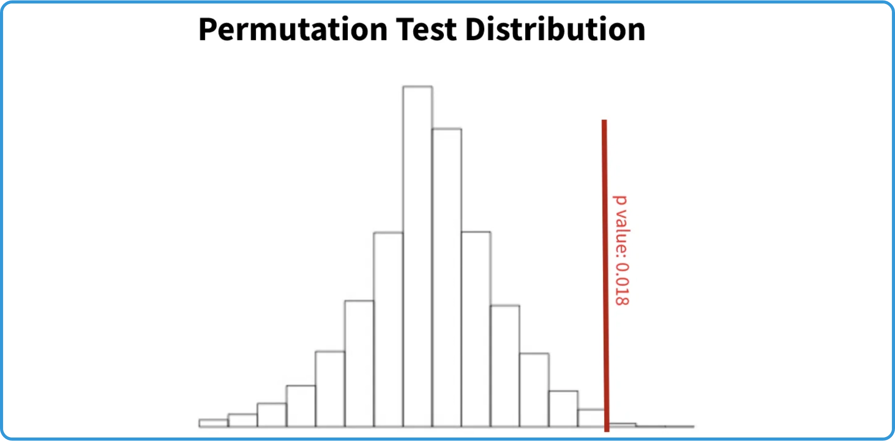

Introduction to Permutation/Randomization Test for MCAR
Definition:
A permutation test is a non-parametric
statistical test that compares the distribution of observed
values between groups with and without missing values.
Purpose:
To determine if data are Missing Completely At
Random (MCAR) by testing whether missingness is related
to observed variables.
Key Insight:
If data are MCAR, the distribution of observed
variables should be the same regardless of whether other
variables have missing values.
Advantages:
Distribution-free, robust to outliers, and can
be applied to various types of data and test statistics.
Mechanism:
Randomly shuffles the missingness indicator
and calculates the test statistic many times to create a null
distribution.

Slide 9

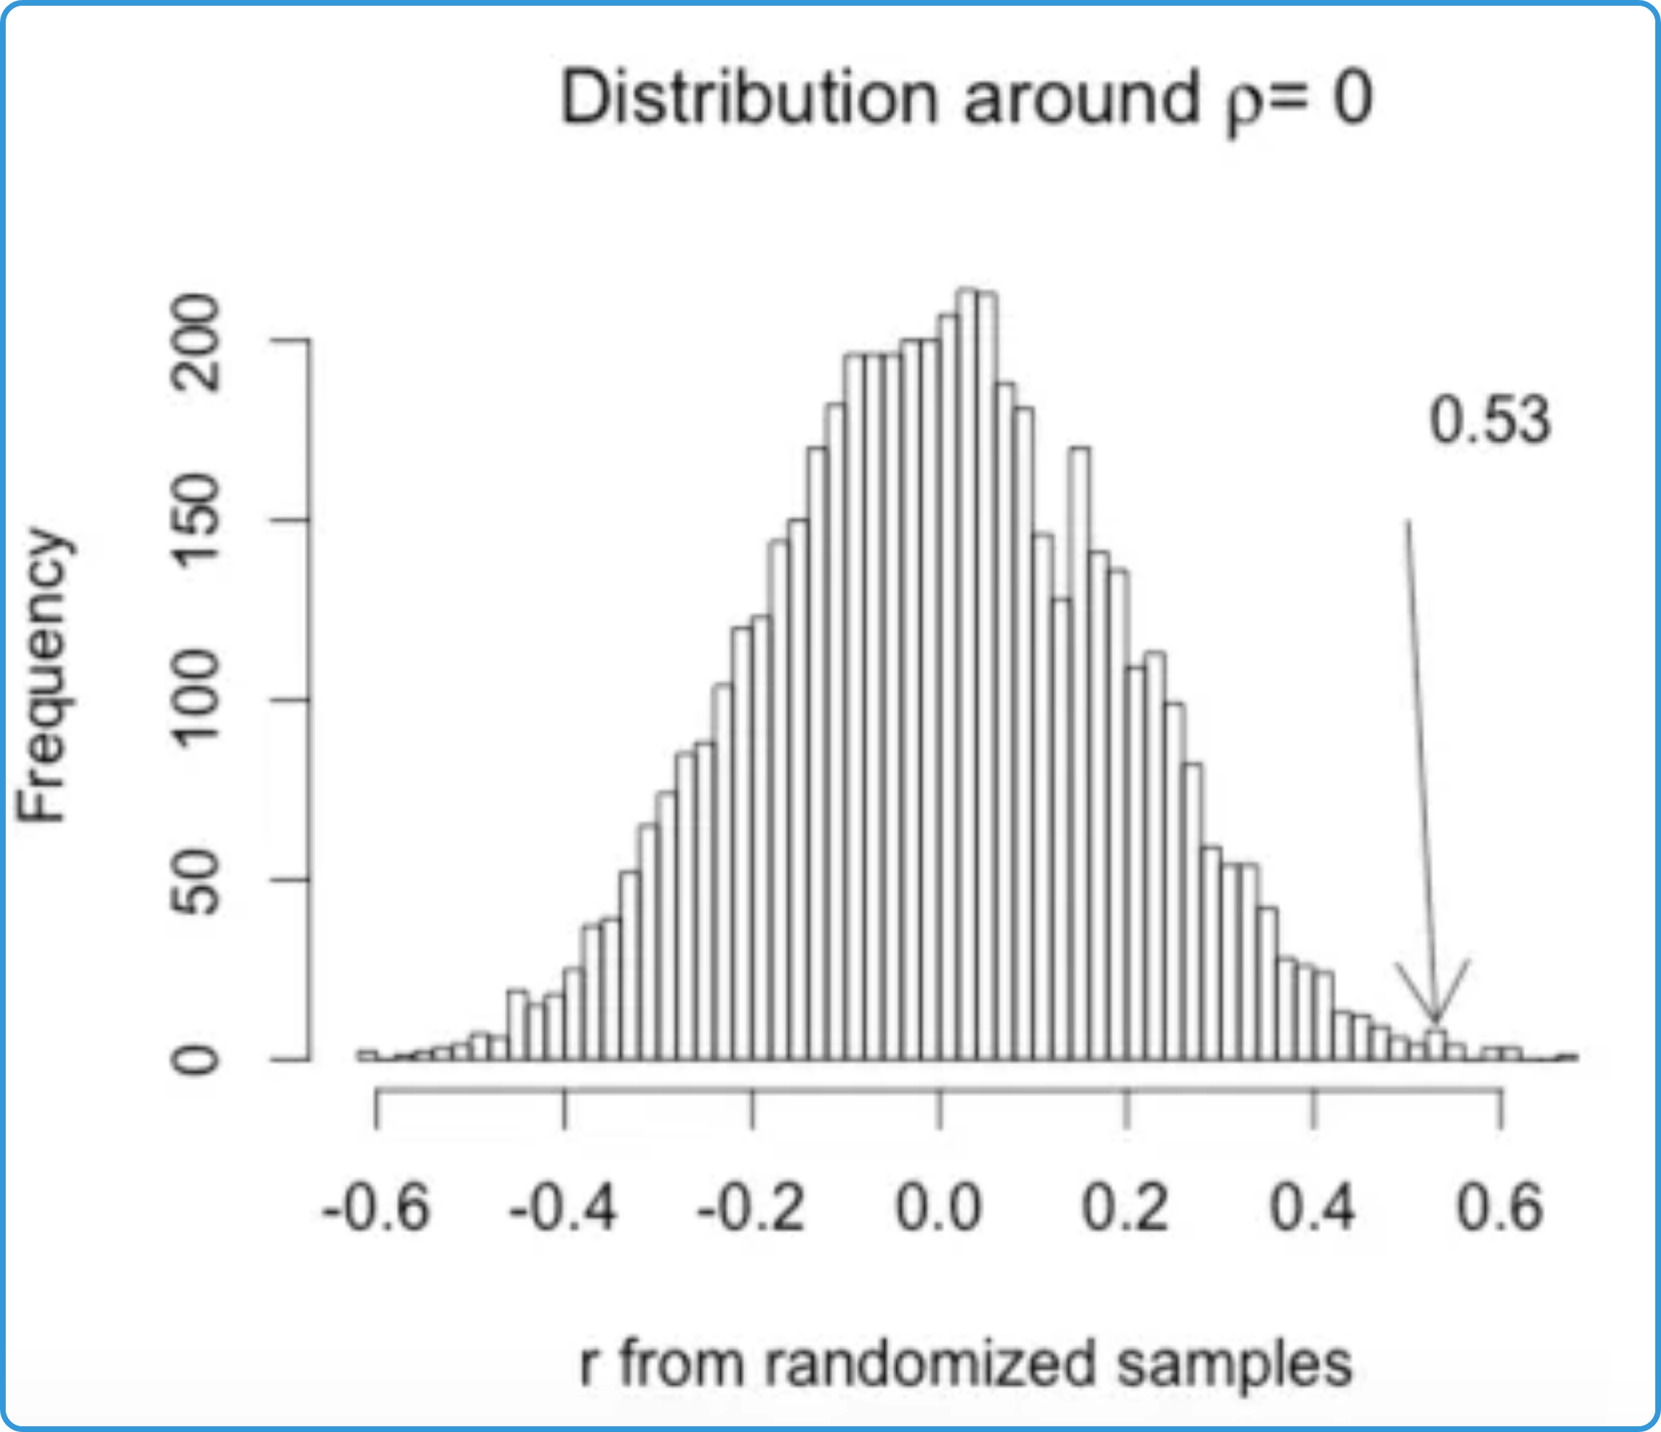

Intuition Behind Permutation Test
Core Question:
Is the distribution of observed values
different between cases with and without missing data?
Randomization Principle:
If missingness is completely
random (MCAR), then shuffling the missingness indicator
should not affect the relationship with other variables.
Null Hypothesis:
The distribution of observed values is the
same regardless of whether other variables have missing
values.
Test Statistic:
Typically the difference in means or
proportions between groups with and without missing
values.
Example:
If income data are MCAR, then the average age of people with missing income should be similar to the average age of people with observed income. Any observed difference should be due to random chance.

Slide 10
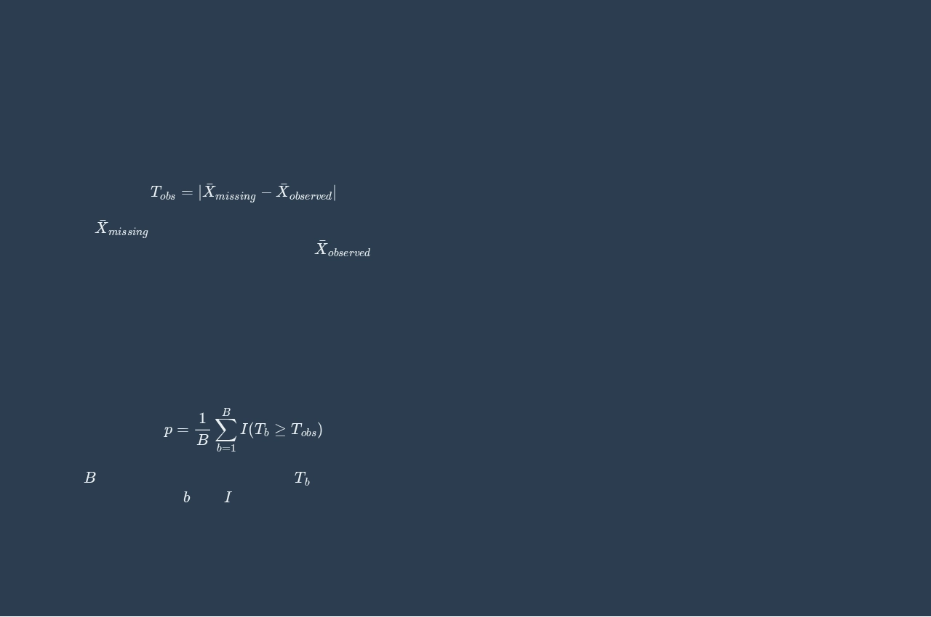

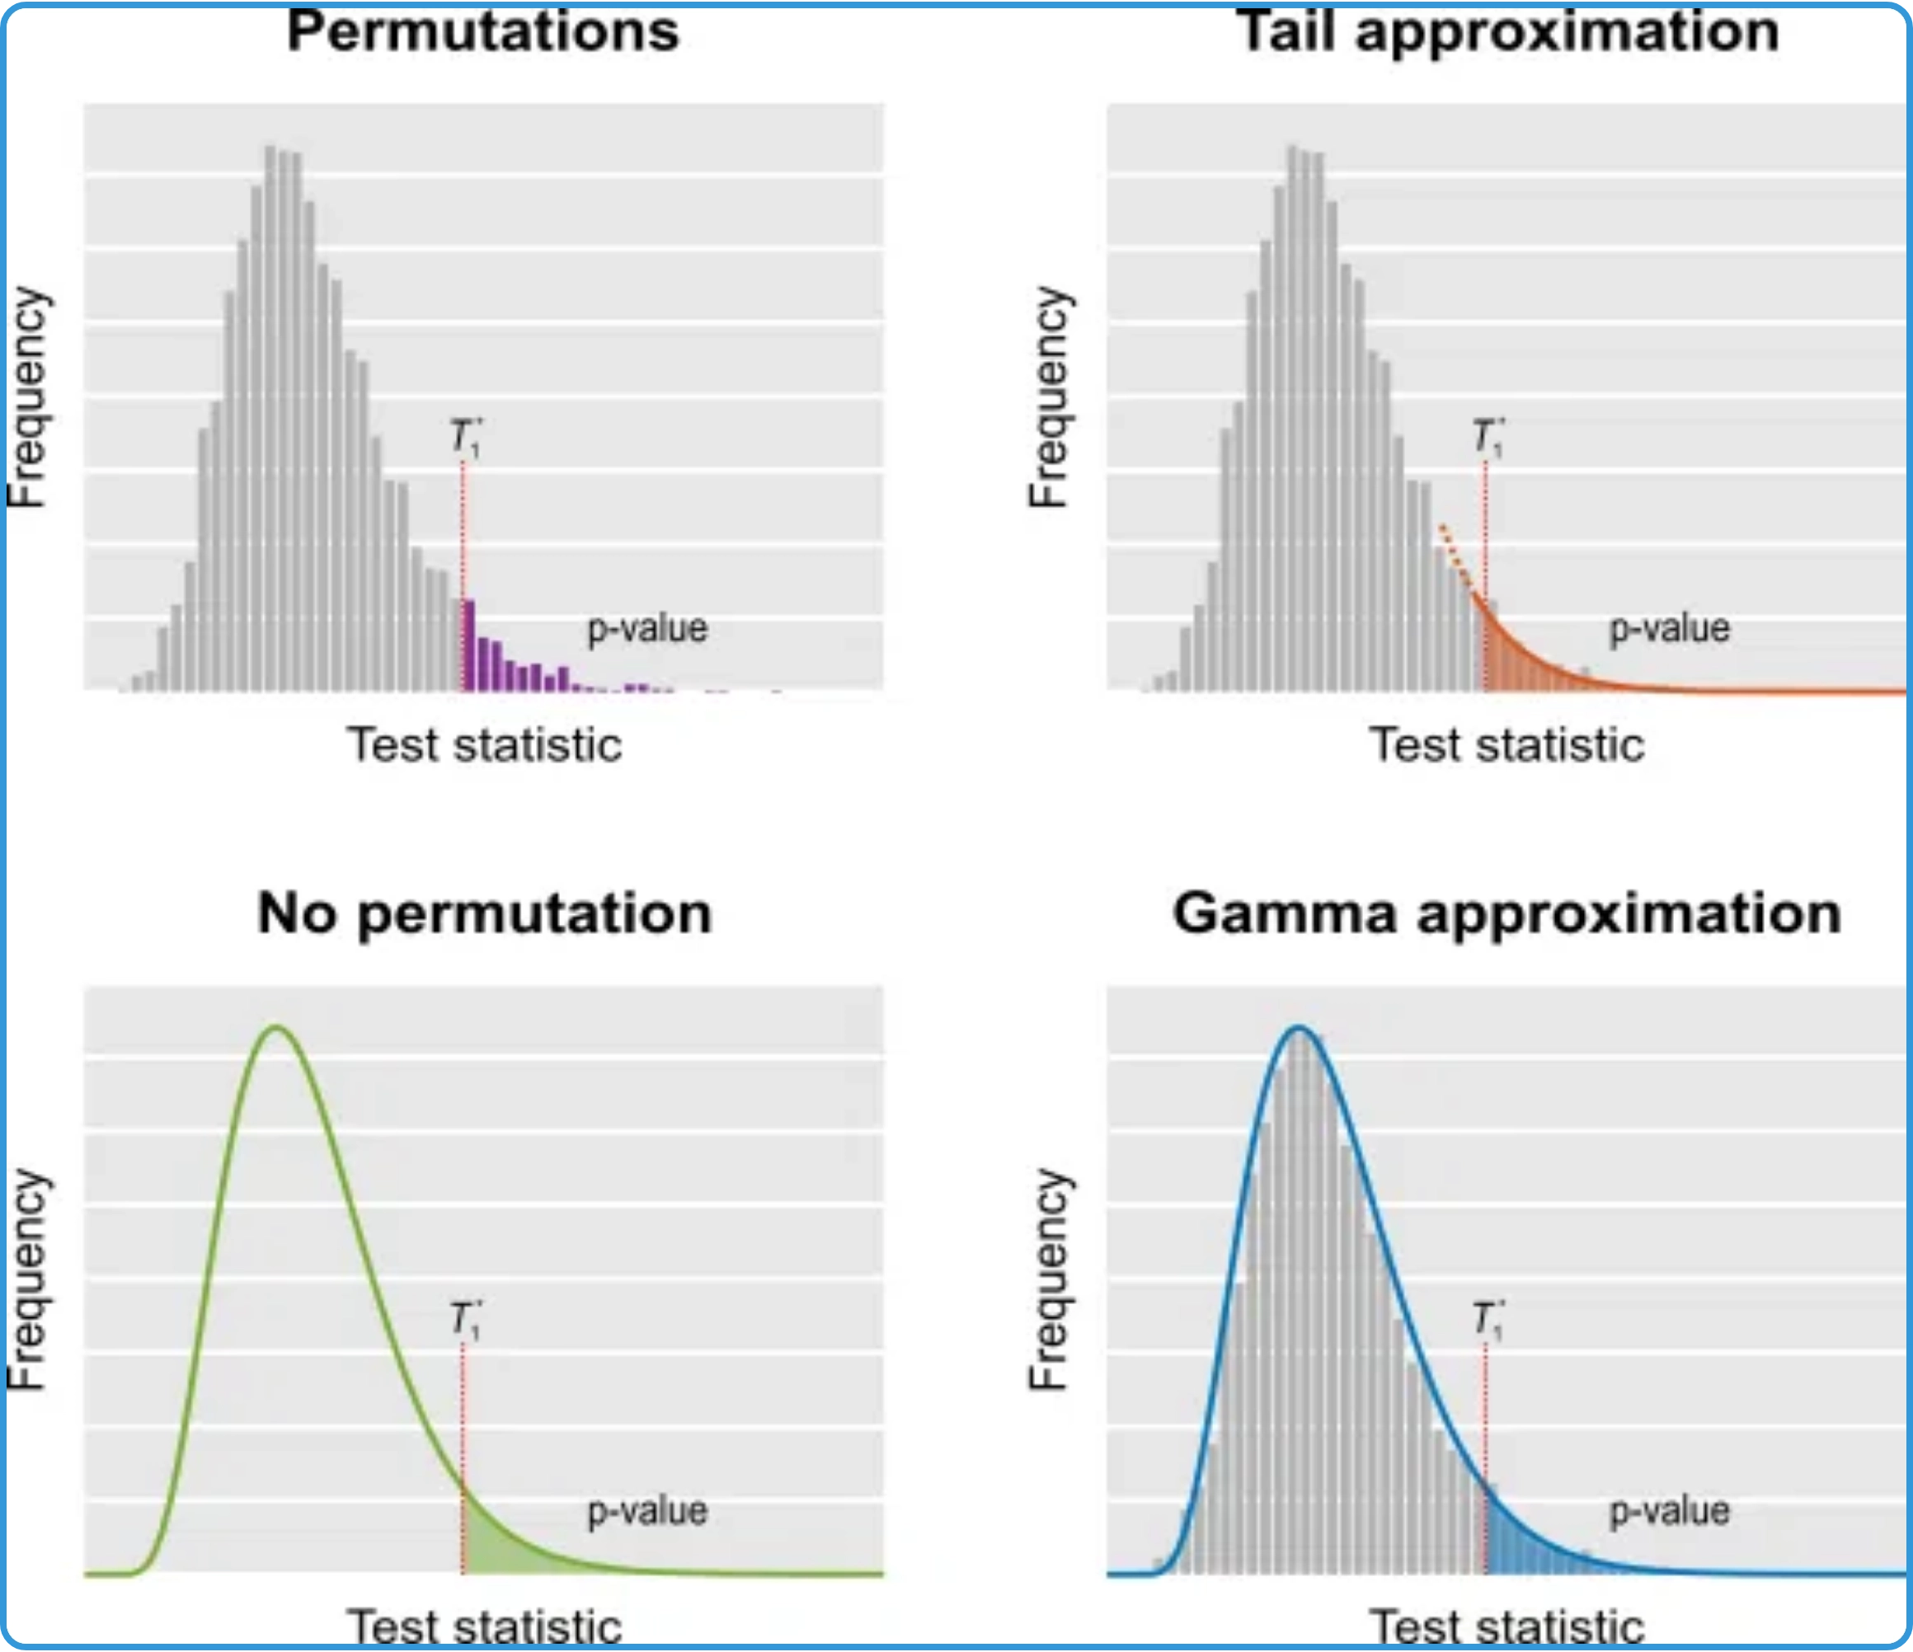


Mathematical Foundation of Permutation Test
Test Statistic:
The difference in means between groups with
and without missing values.
where
is the mean of the observed variable for cases
¯
with missing values in another variable, and
X
o
b
s
e
r
v
e
d
is the mean
for cases without missing values.
Permutation Distribution:
Generated by randomly
shuffling the missingness indicator and recalculating the
test statistic many times.
where
is the number of permutations,
b
is the test statistic for
permutation
b
, and
is the indicator function.
Decision Rule:
Reject the null hypothesis (MCAR) if the p-
value is less than the significance level (e.g., 0.05).

Slide 11


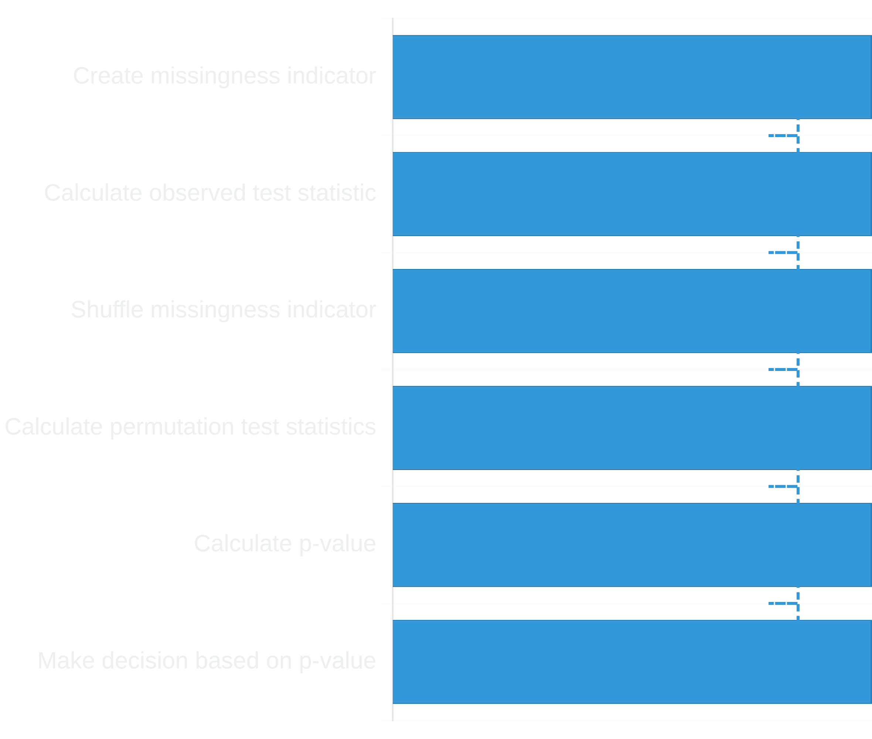
Implementation of Permutation Test
Algorithm Steps:
1. Calculate observed test statistic:
- Create missingness indicator for variable with missing values
- Calculate mean of comparison variable for both groups
- Compute difference between means (observed test statistic)
2. Generate permutation distribution:
- For i = 1 to n_permutations:
a. Randomly shuffle the missingness indicator
b. Calculate mean difference with shuffled indicator
c. Store this permutation test statistic
3. Calculate p-value:
- Count how many permutation statistics are >= observed
- Divide by total number of permutations
4. Make decision:
- If p-value < 0.05, reject MCAR hypothesis
- Otherwise, fail to reject MCAR hypothesis

Slide 12

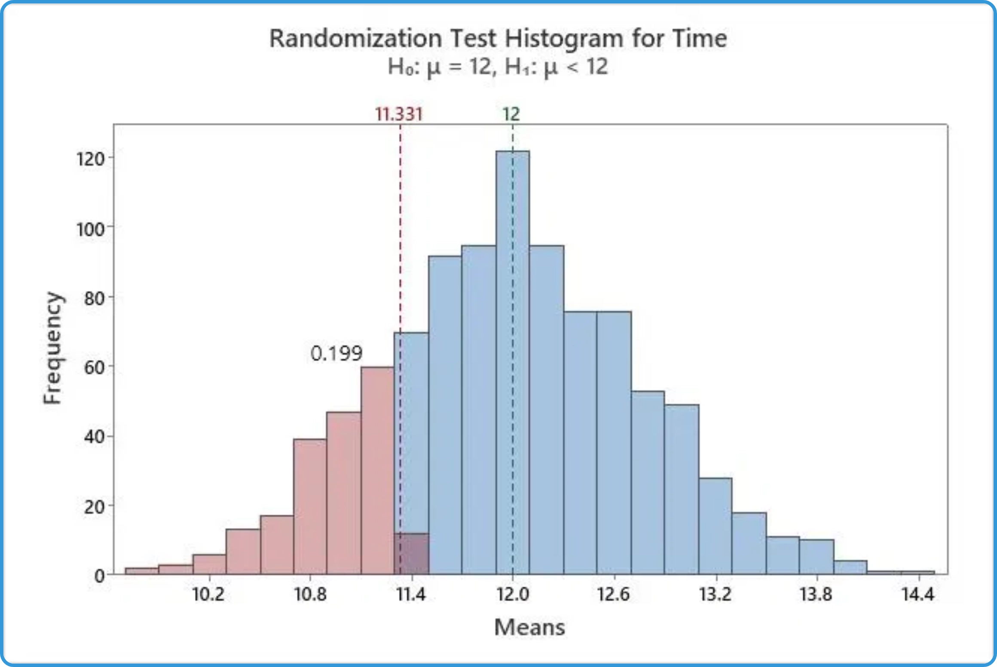

Interpreting Permutation Test Results
P-value Interpretation:
The proportion of permutations
where the test statistic is as extreme or more extreme than
the observed value.
Decision Rule:
If p-value < 0.05, reject the null hypothesis
that data are MCAR.
Example Interpretation:
p = 0.82
Fail to reject MCAR. No evidence that missingness is related to observed variables.
p = 0.03
Reject MCAR. Evidence suggests missingness is related to observed variables (MAR or MNAR).
p = 0.06
Borderline case. Consider additional tests or variables before making a conclusion.
Important Note:
A significant result only indicates that
data are not MCAR, but doesn't distinguish between MAR
and MNAR.

Slide 13

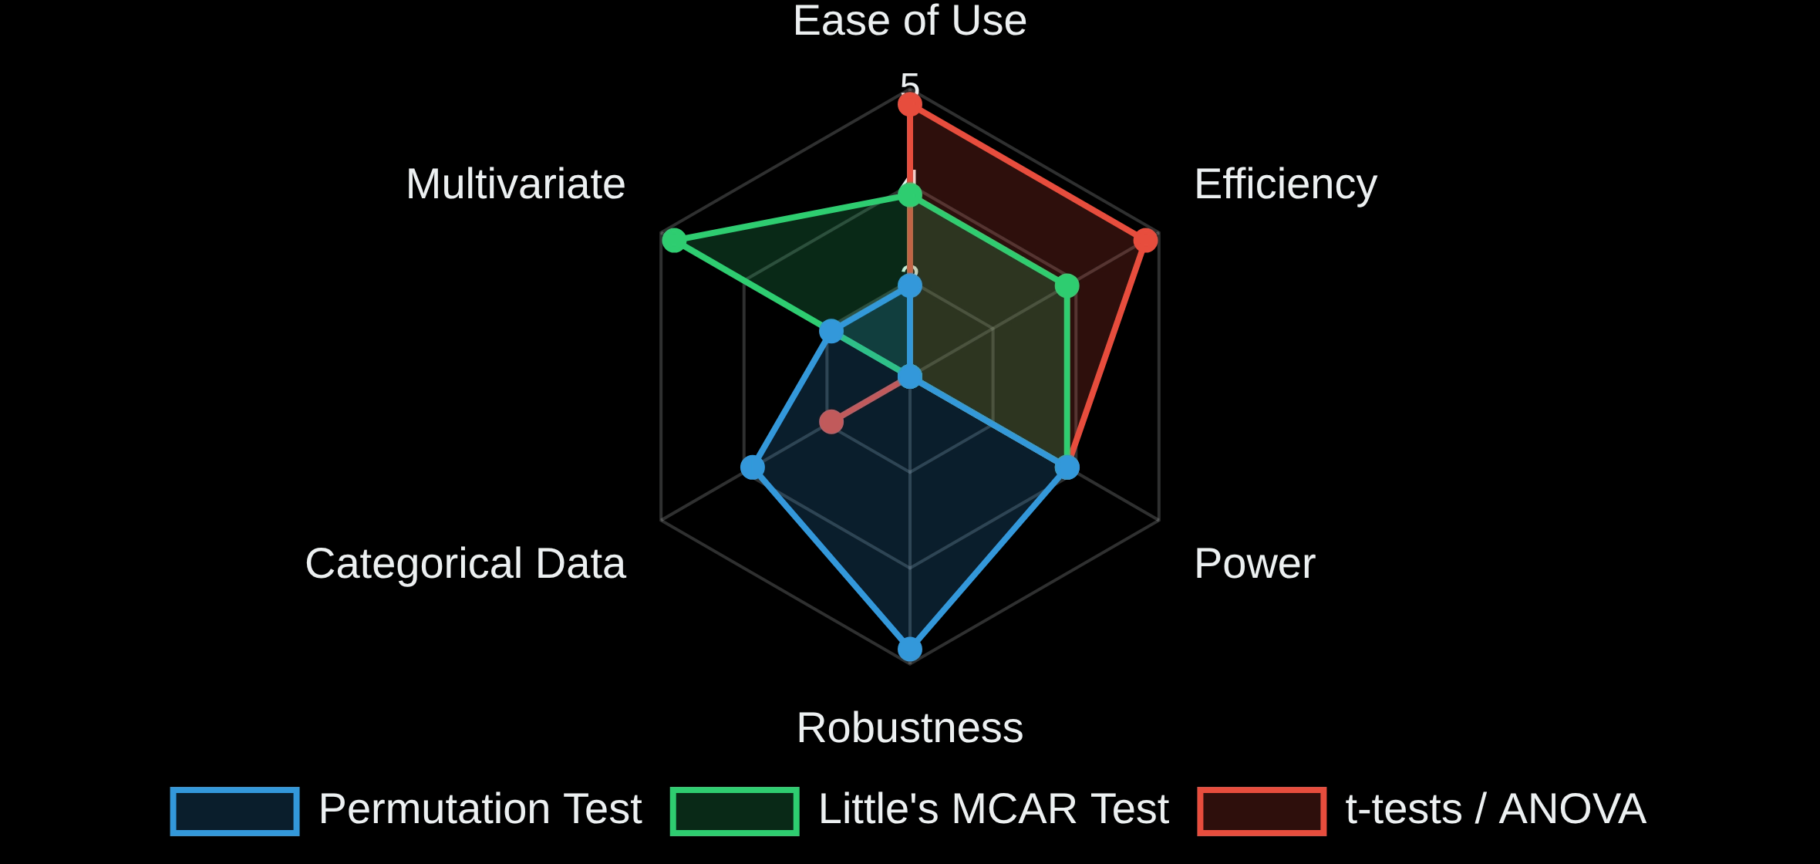
Comparing Permutation Test with Other MCAR Tests
Test
Strengths
When to Use
Permutation Test
Distribution-free (non-parametric)
When parametric assumptions are violated
Robust to outliers
Flexible with test statistics
Little's MCAR Test
Tests all variables simultaneously
For multivariate continuous datasets
Well-established in literature
Single comprehensive p-value
t-tests / ANOVA
Simple to implement
For quick assessment with normal data
Widely available in software
Good statistical power

Slide 14

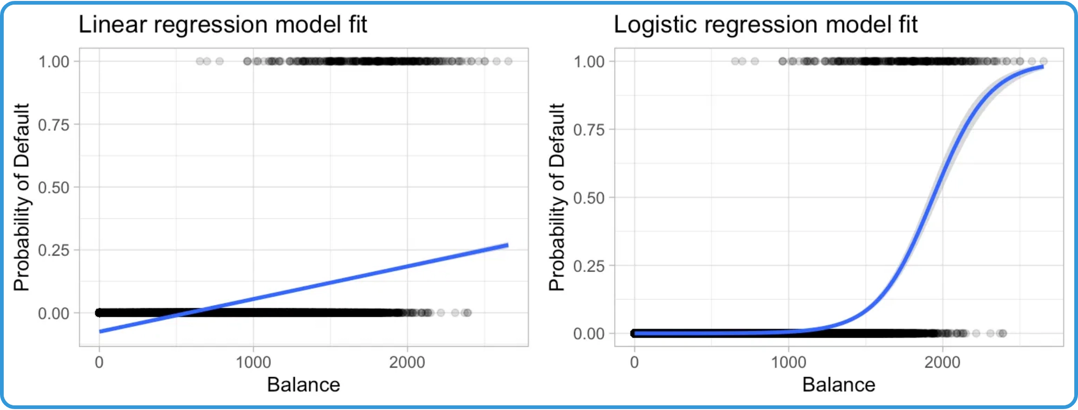

Introduction to Logistic Regression Test for MAR
MAR Mechanism:
Missing At Random (MAR) occurs when
the probability of missingness depends on observed data
but not on unobserved data.
MAR Definition: P(R|Y
obs
, Y
mis
) = P(R|Y
obs
)
Where R is the missingness indicator, Y
obs
is observed data, and Y
mis
is
missing data.
Testing Approach:
Use logistic regression to model the
probability of missingness as a function of observed
variables.
Key Insight:
If observed variables significantly predict
missingness, data are likely MAR rather than MCAR.
Theoretical Foundation:
Based on Rubin's (1976) missing
data framework, which formalized the concepts of MCAR,
MAR, and MNAR.
Practical Value:
Helps determine if multiple imputation or
maximum likelihood methods (which assume MAR) are
appropriate.

Slide 15
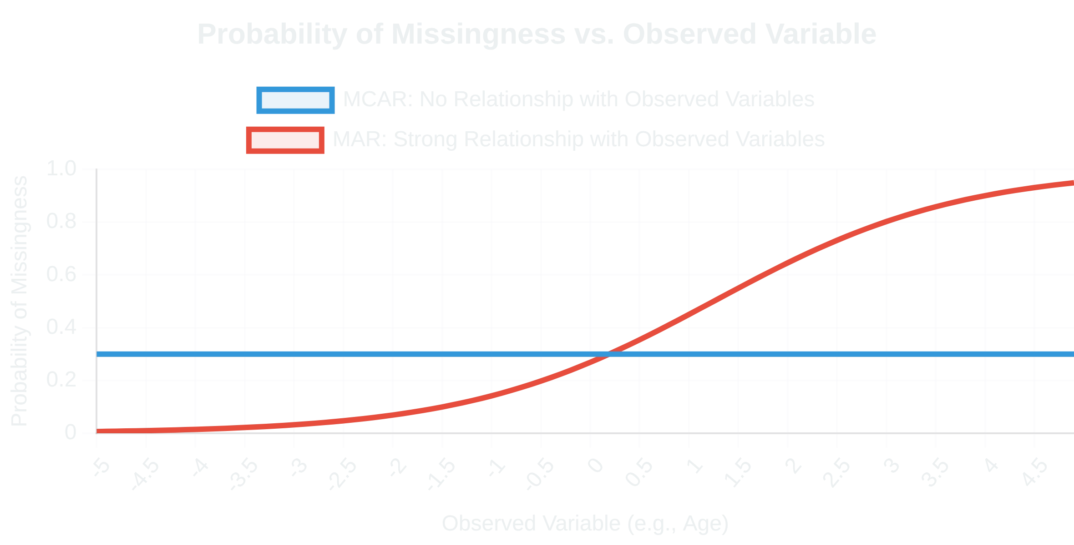


Intuition Behind the Logistic Regression Test
Missingness as a Binary Outcome:
Create indicator
variables (R) where 1 = missing and 0 = observed for each
variable with missing values.
Observed Variables as Predictors:
Use observed variables
(X) to predict the missingness indicators (R) through logistic
regression.
MAR Intuition:
If missingness is related to observed
variables (MAR), then these variables should significantly
predict the missingness pattern.
MCAR vs. MAR:
Under MCAR, no observed variable should
Example:
In blood pressure (BP) data with missing values:
predict missingness. Significant predictors suggest MAR
If age predicts missing BP values, data are MAR
mechanism.
If no variables predict missing BP, data may be MCAR
If BP itself predicts its missingness, data are MNAR

Slide 16
Intuition Behind the Logistic Regression Test
For each column X with missing values:
Create R_X = indicator( X is missing )
Fit logistic regression:
Dependent = R_X
Independent = all other observed columns
If any independent variable is significant (p<0.05):
Missingness likely depends on observed data → evidence for MAR
Else:
Missingness likely MCAR
Example:
In blood pressure (BP) data with missing values:
If age predicts missing BP values, data are MAR
If no variables predict missing BP, data may be MCAR
If BP itself predicts its missingness, data are MNAR

Slide 17
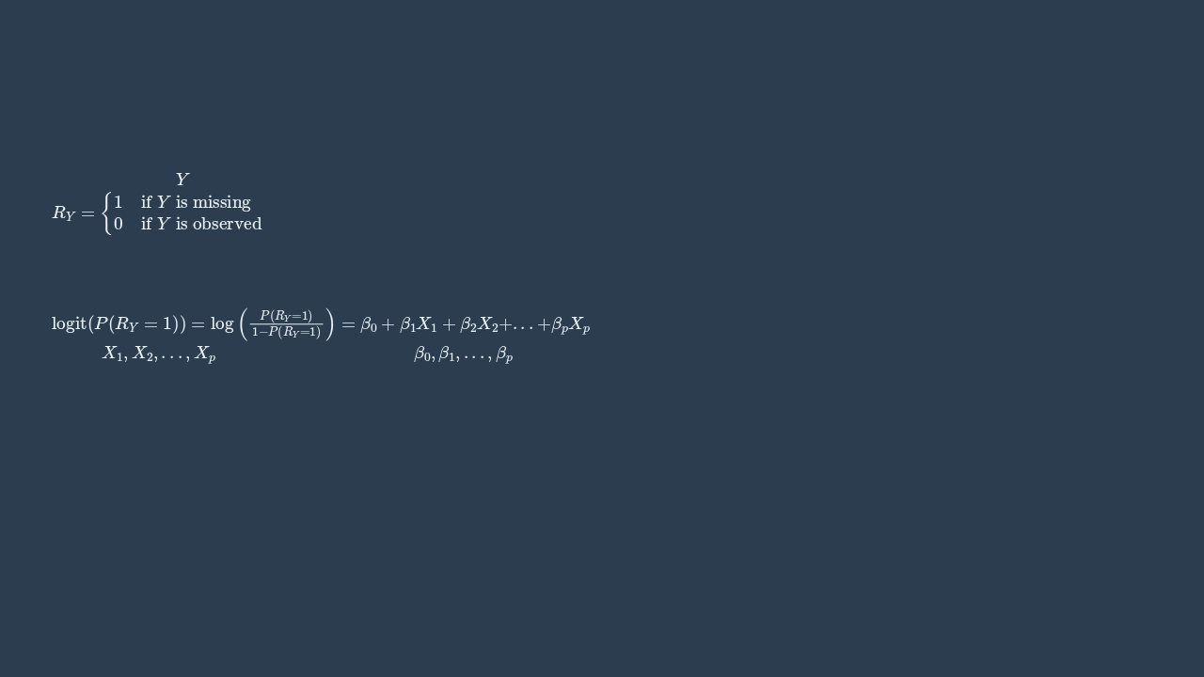

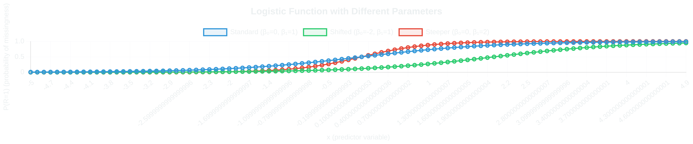
Mathematical Foundation of Logistic Regression Test - Part 1
Logistic Regression Model Setup:
We model the probability of missingness as a function of observed variables.
For each variable
with missing values, create a missingness indicator:
Logit Transformation:
We use the logit link function to model the relationship.
Where
are observed variables and
are coefficients

Slide 18
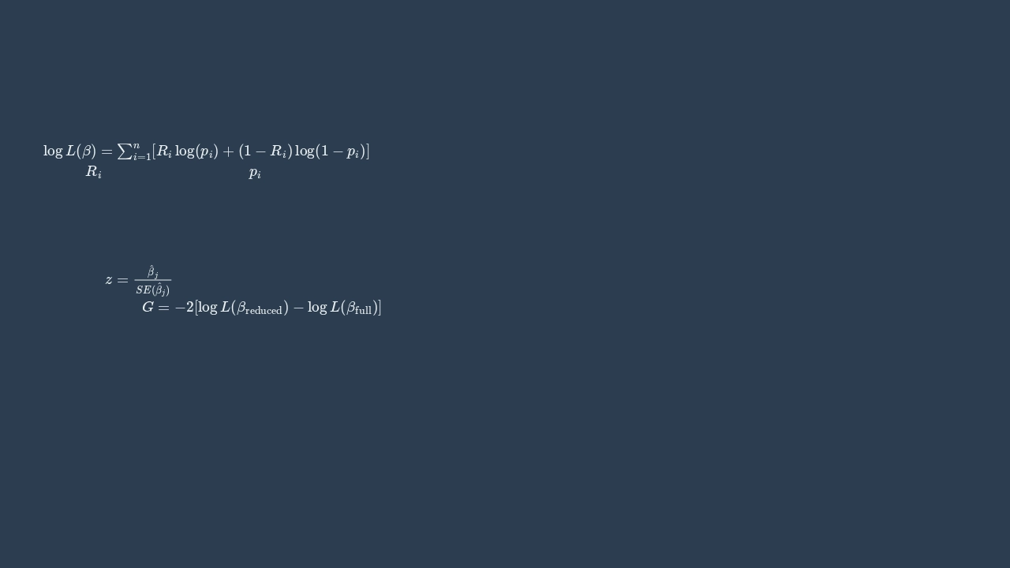

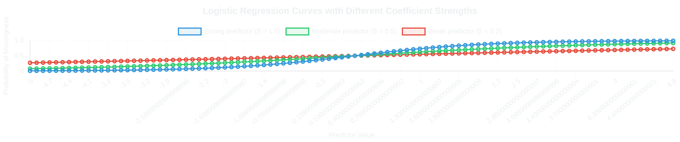
Mathematical Foundation of Logistic Regression Test - Part 2
Maximum Likelihood Estimation:
Parameters are estimated by maximizing the log-likelihood function.
Where
i
= missingness indicator,
i
= probability of missingness
Coefficient Significance Testing:
Wald test or likelihood ratio test is used to assess if predictors significantly affect
missingness.
Wald test:
Likelihood ratio:

Slide 19
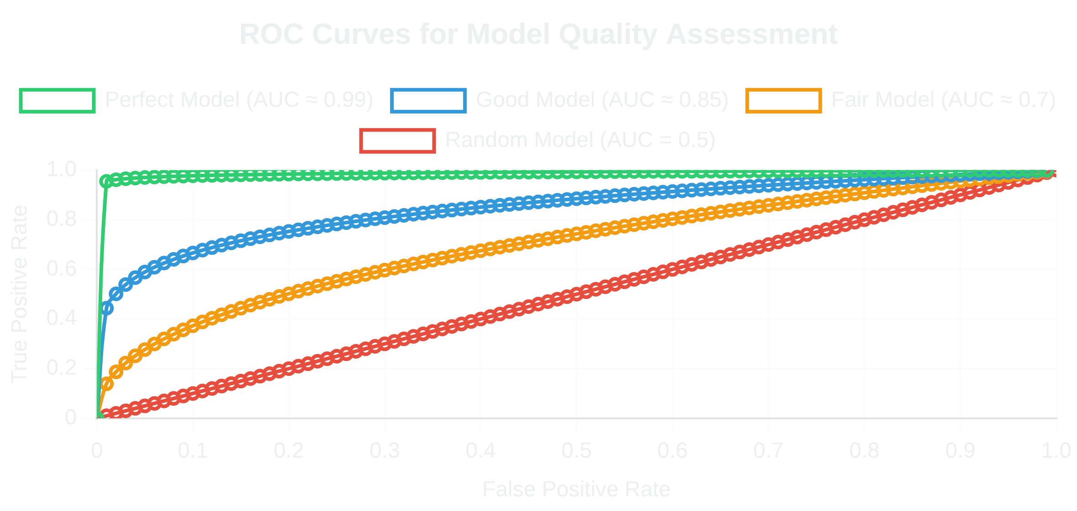
Implementation Strategy for Logistic Regression Test
Variable Selection:
Include relevant observed variables
that might predict missingness, avoiding overfitting.
Implementation Steps:
1
Create binary missingness indicators (R) for variables with missing values
2
Select potential predictor variables (X) from fully observed variables
3
Fit logistic regression model: R ~ X₁ + X₂ + ... + Xₚ
4
Test model significance with likelihood ratio test
5
Examine coefficient significance with Wald tests
Diagnostic Checks:
Assess model fit using ROC curve,
Hosmer-Lemeshow test, and other standard logistic
Software:
Easily implemented in R, Python, SAS, or SPSS
regression diagnostics.
using standard logistic regression functions.
# R implementation example
missing_indicator <- is.na(data$variable)
model <- glm(missing_indicator ~ predictor1 + predictor2,
family = binomial(link = "logit"), data = data)
summary(model) # Check significance

Slide 20
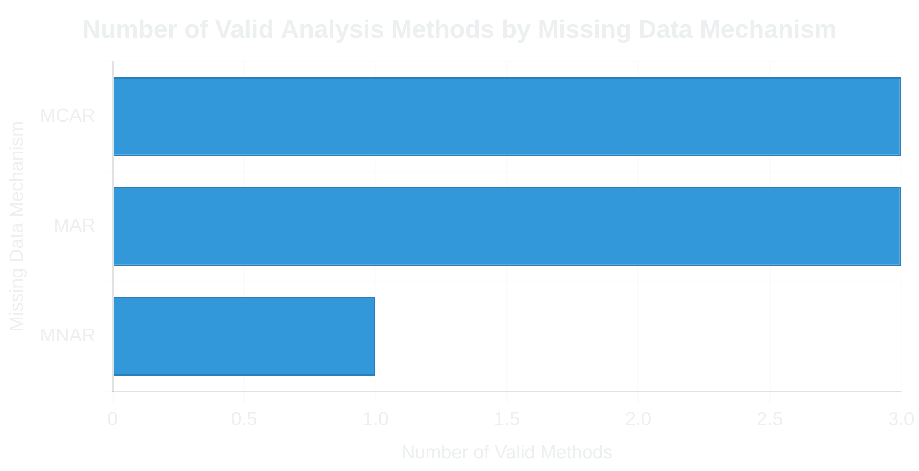

Interpretation and Applications of Logistic Regression Test
Significant vs Non-significant Predictors:
If any observed
Practical Implications:
variable significantly predicts missingness, data are likely
MAR rather than MCAR.
Effect Size Interpretation:
Odds ratios from logistic
regression quantify how strongly each variable predicts
missingness.
Model Validation:
Cross-validation or split-sample
validation can strengthen confidence in findings.
Interpretation Guidelines:
If no predictors are significant: Consistent with MCAR
Important Caveat:
This test can confirm MAR (when
If observed variables predict missingness: Consistent with MAR
significant predictors exist), but cannot definitively rule out
Cannot directly test for MNAR (would require the missing values)
MNAR mechanisms.

Slide 21

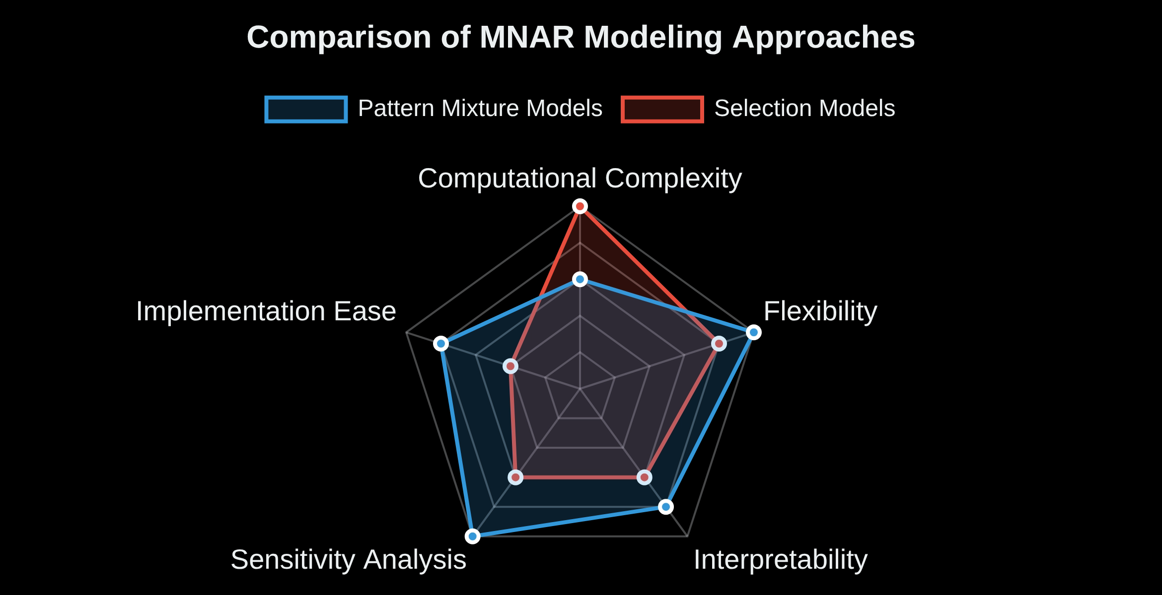


Introduction to Pattern Mixture for MNAR
Alternative MNAR Testing Approach:
Pattern mixture
models can be extended to handle MNAR
mechanisms by allowing pattern-specific parameter
distributions.
Pattern-Specific Distributions:
Unlike MAR testing, MNAR
pattern mixture models explicitly allow different
distributions for different missing data patterns.
Flexibility Advantages:
More flexible than selection
models as they don't require explicit modeling of the
missingness mechanism.
Key Insight:
By allowing parameters to vary freely across
patterns, pattern mixture models can capture MNAR
Comparison with Selection Models:
mechanisms without explicitly modeling them.
Pattern mixture: Conditions on missingness patterns
Selection model: Conditions on complete data
Testing Approach:
Compare models with different
Pattern mixture models are often more computationally tractable
constraints on pattern-specific parameters to assess
evidence for MNAR mechanisms.

Slide 22

Intuition Behind Pattern Mixture Test for MNAR
Pattern-Specific Distributions:
Under MNAR, the
distribution of variables differs systematically across
missing data patterns, even after accounting for observed
covariates.
Identifying MNAR:
Look for systematic differences in
parameter estimates across patterns that cannot be
explained by observed variables.
Key Insight:
If missingness depends on unobserved values
(MNAR), then the distribution of observed data will differ
systematically across patterns.
Real-World Example:
Testing Approach:
Compare models with different
In a depression study, patients with more severe symptoms might be more likely to drop out. The observed depression scores in the "dropout" pattern would be systematically lower than in the "complete" pattern, even after controlling for baseline characteristics.
constraints on pattern-specific parameters to assess
evidence for MNAR mechanisms.
Advantage:
More intuitive interpretation than selection
models, as differences between patterns directly reflect
the impact of missing data.

Slide 23
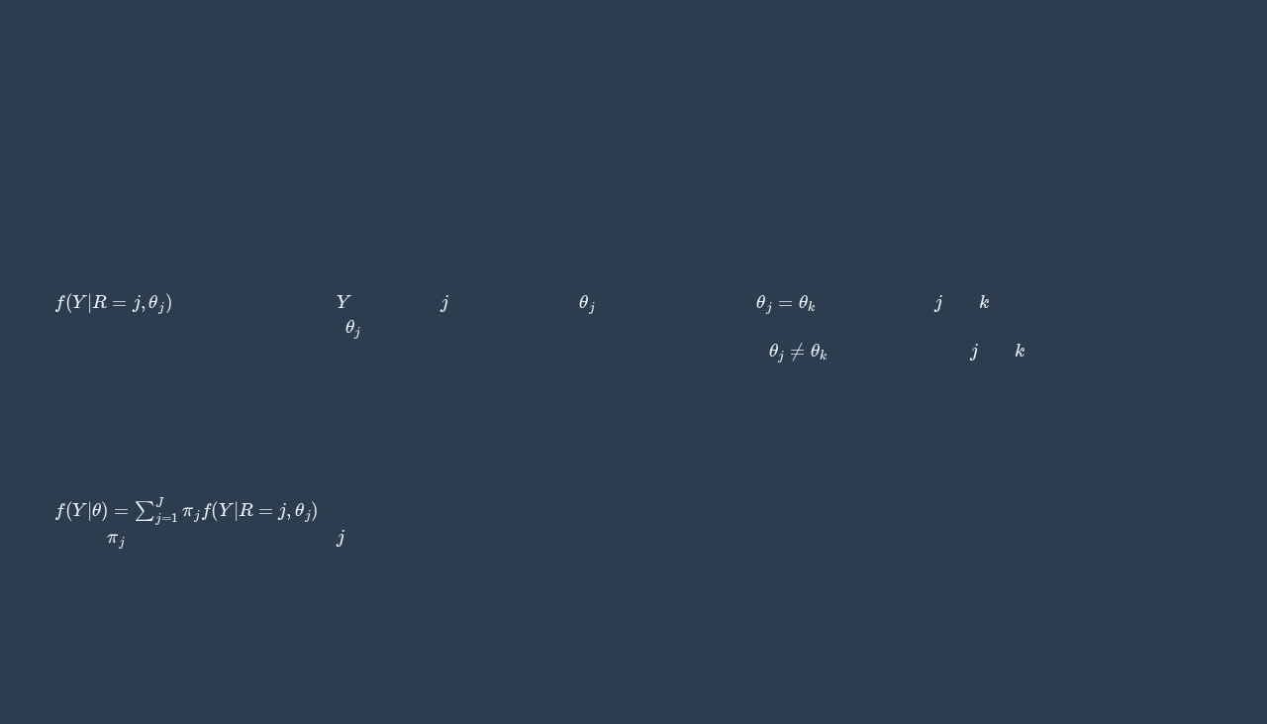

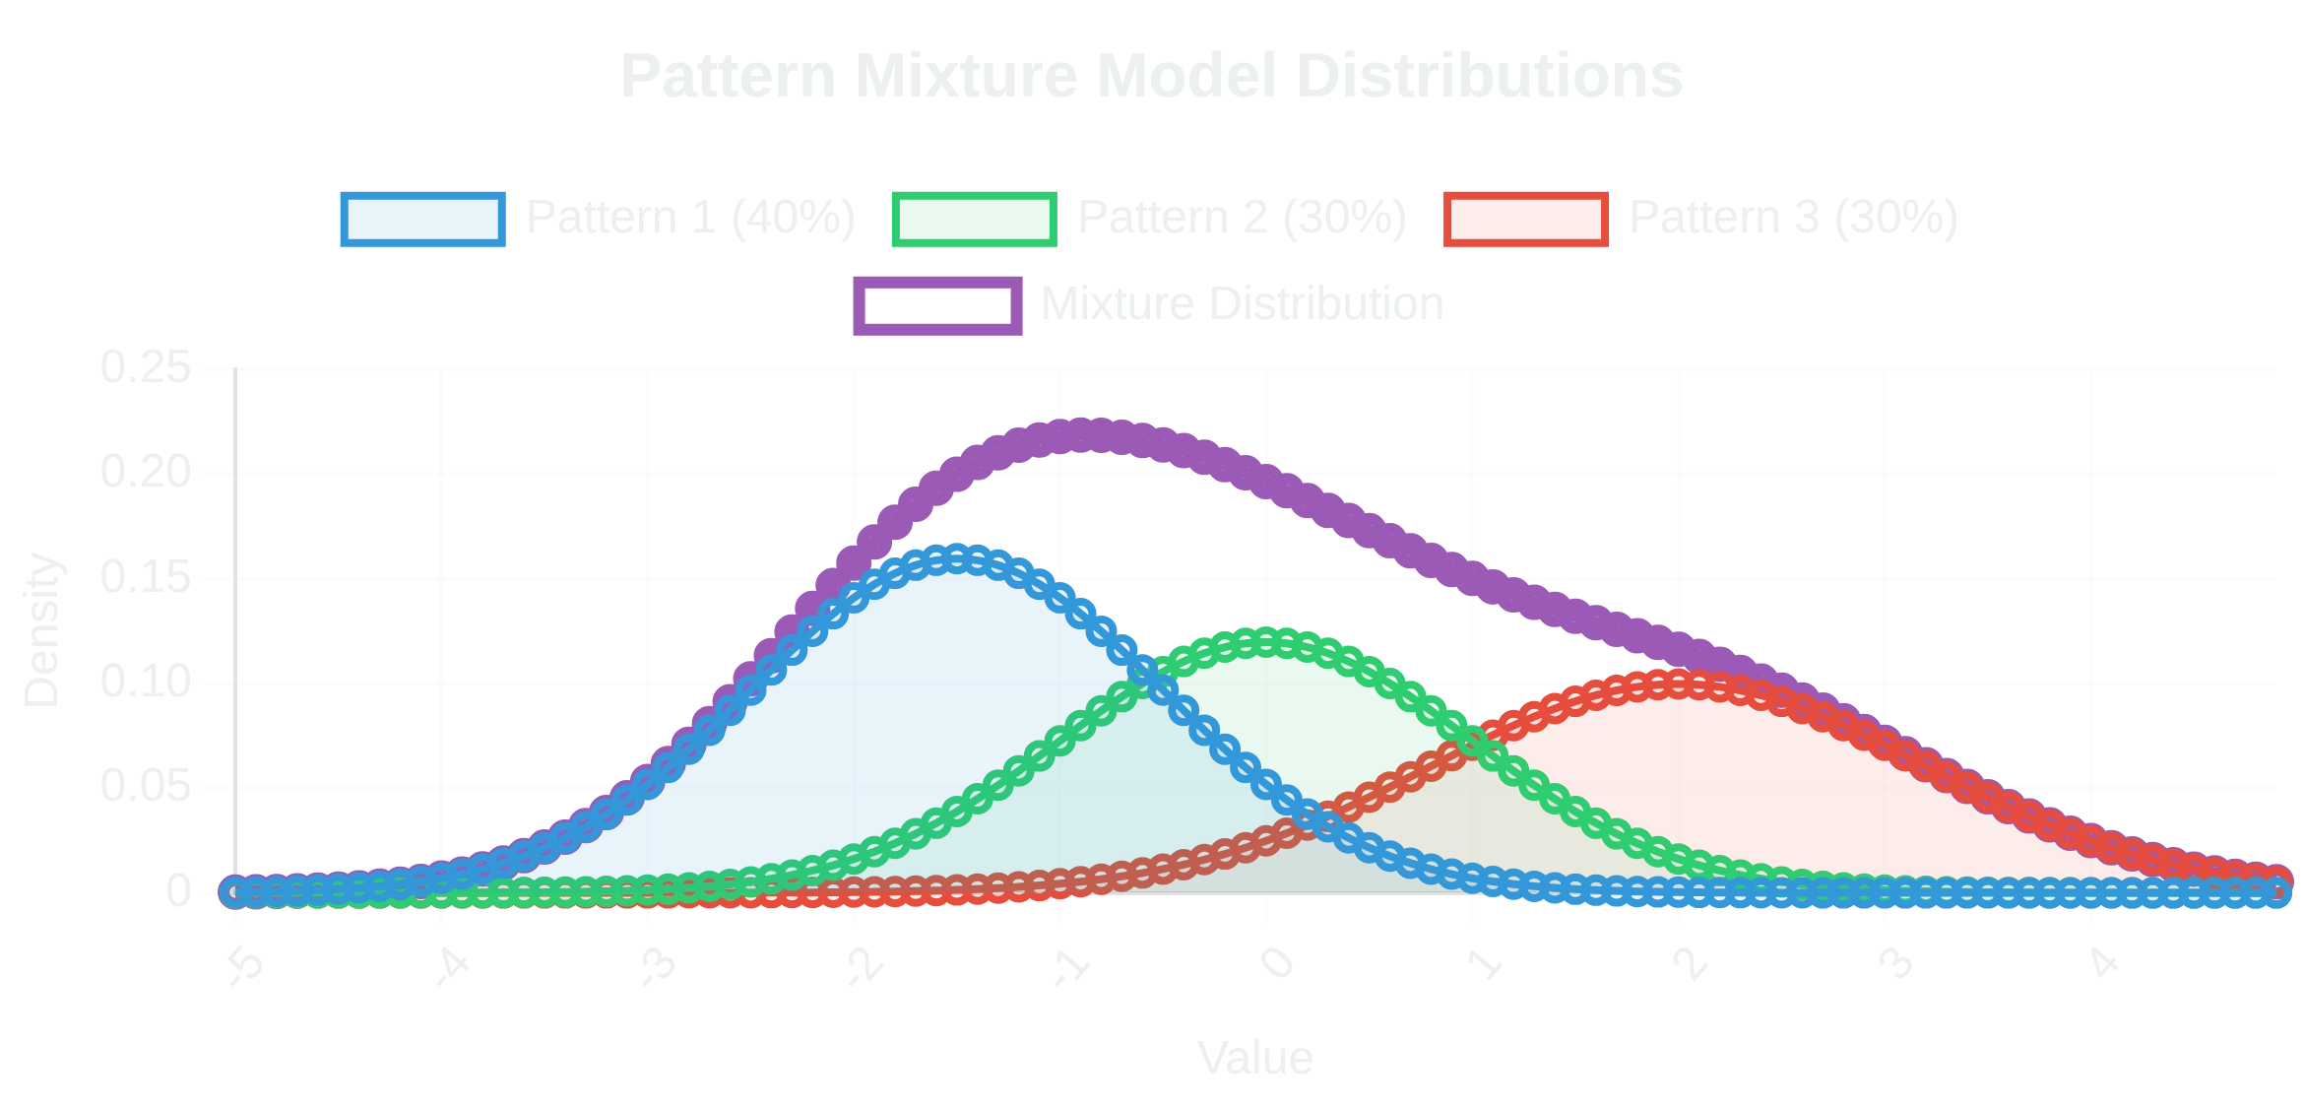
Mathematical Foundation of Pattern Mixture Test for MNAR - Part 1
Pattern-Specific Distributions:
In MNAR pattern mixture
Identifying MNAR:
Test whether pattern-specific
models, we explicitly allow different distributions for each
parameters differ in ways that cannot be explained by
missing data pattern.
observed variables alone.
= distribution of data
Y
for pattern
j
with parameters
θ
j
Under MAR:
θ
j
=
θ
k
for all patterns
j
and
k
after conditioning on
Unlike MAR testing, we don't constrain
θ
j
to be equal across patterns
observed variables
after conditioning on observed variables.
Under MNAR:
θ
j
≠
θ
k
for some patterns
j
and
k
even after conditioning
on observed variables
Mixture Distribution:
The marginal distribution of the
data is a weighted mixture of pattern-specific
distributions.
J
Where
j
is the probability of pattern
j
occurring.

Slide 24

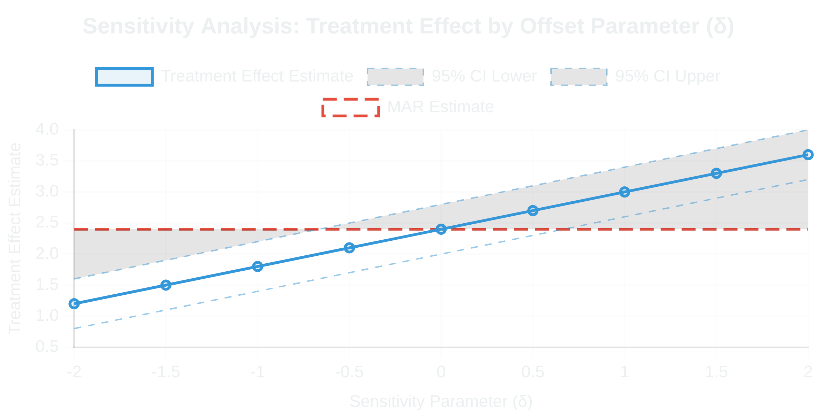
Implementation of Pattern Mixture Test for MNAR
Implementation Strategy:
Pattern mixture models for
Sensitivity Analysis:
Critical component of MNAR pattern
MNAR require explicit modeling of pattern-specific
mixture modeling to assess robustness of conclusions.
distributions and sensitivity parameters.
Implementation Steps:
1
Identify all missing data patterns in the dataset
2
Fit separate models for each pattern with sufficient observations
3
Introduce sensitivity parameters to quantify departures from MAR
4
Perform sensitivity analysis across plausible values of these parameters
5
Compare results to MAR-based analyses to assess impact of MNAR assumptions
Software Implementation:
Can be implemented in
Identification Challenges:
Requires constraints or
specialized packages like SAS PROC MI, R packages (mitml,
informative priors to identify unidentified parameters in
mice), or Bayesian software (JAGS, Stan).
the model.
Practical Considerations:
Balance model complexity
against available data; simpler models may be more
stable with limited sample sizes.

Slide 25

Pattern mixture model
Step 1 — Data and Missingness Mechanism
Created a dataset df_complete with:
Continuous: age, income, education_years, health_score
Categorical: gender, city
Then we created MNAR missingness:
For income, high earners are more likely to NOT report it → Missingness depends on high unobserved income values
For health_score, low scorers are more likely to NOT report it → Missingness depends on low unobserved health values
This is Missing Not At Random (MNAR) because:
The probability of being missing depends on the value itself. $P\left(R=0∣Y\right)$depends directly on $Y$.

Slide 26
Pattern mixture model
Instead of assuming MAR (which fails here),
PMMs split the dataset by missingness pattern and model each group separately.
In our data, the main patterns are:
A = complete data
B = income missing only (high earners group)
C = health missing only (low health group)
D = both missing (mixed group — rare here)
Pattern | income missing? | health_score missing?
A | No | No
B | Yes | No
C | No | Yes
D | Yes | Yes

Slide 27
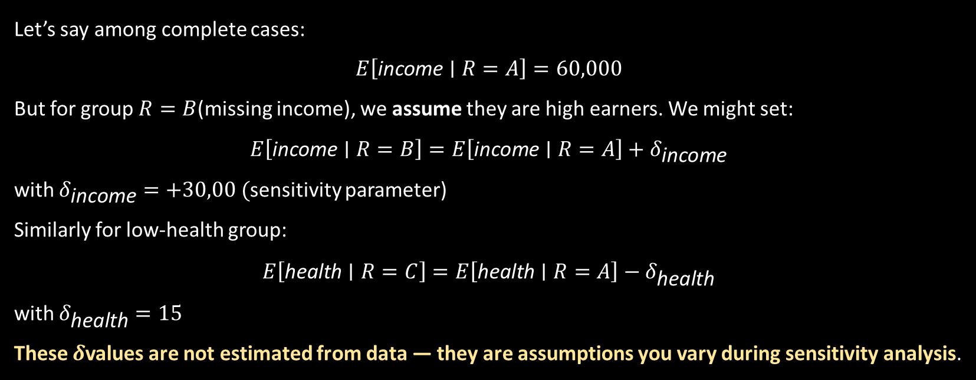
Pattern mixture model
Let’s say among complete cases:
$$E\left[\text{income}∣R=A\right]=60,000$$
But for group $R=B$(missing income), we assume they are high earners. We might set:
$$E\left[\text{income}∣R=B\right]=E\left[\text{income}∣R=A\right]+δ_{\text{income}}$$
with $δ_{\text{income}}=+30,00 ($sensitivity parameter)
Similarly for low-health group:
$$E\left[\text{health}∣R=C\right]=E\left[\text{health}∣R=A\right]−δ_{\text{health}}$$
with $δ_{\text{health}}=15$
These $δ$values are not estimated from data — they are assumptions you vary during sensitivity analysis.
Pattern | income missing? | health_score missing?
A | No | No
B | Yes | No
C | No | Yes
D | Yes | Yes

Slide 28

Pattern mixture model
Once we specify assumed means (or full distributions) for the missing parts, we combine across patterns:
$$E\left[Y\right]=\sum_{r}{P}\left(R=r\right) E\left[Y∣R=r\right]$$
Where $P\left(R=r\right)$is simply the proportion of data in each pattern (can be counted from dataset).
This gives overall estimates that account for the fact that missing values likely differ from observed ones — which is exactly what MNAR means.
Pattern | income missing? | health_score missing?
A | No | No
B | Yes | No
C | No | Yes
D | Yes | Yes

Slide 29


Summary and Recommendations for Missing Data Tests
Comprehensive Testing Strategy:
Use multiple tests to
build a more complete understanding of missing data
mechanisms.
Hierarchical Approach:
Start with MCAR tests, proceed to
MAR tests if MCAR is rejected, and consider MNAR tests if
concerns remain.
Limitations:
All tests have assumptions and limitations; no
single test can definitively identify the true missing data
mechanism.
Key Recommendations:
Combine statistical tests with substantive knowledge about the data generation process
Best Practice:
Regardless of test results, use modern
missing data methods (multiple imputation, maximum
Conduct sensitivity analyses to assess robustness to different missing data assumptions
likelihood) that are robust under MAR assumptions.
Report results from multiple tests and approaches
Future Directions:
Ongoing research is developing more
powerful tests and methods that are robust to various
Consider the practical implications of different missing data mechanisms for your specific analysis goals
missing data mechanisms.

